Slide 1
Version Control using Git

Slide 2
OBJECTIVES
Version Control
Setup Git environment
Create a Git repository ( adding file, adding folder)
Checkout different version/ignore files…
Fixing mistakes
Git , Git repository
Git vs Github
Collaboration with other developers

Slide 3
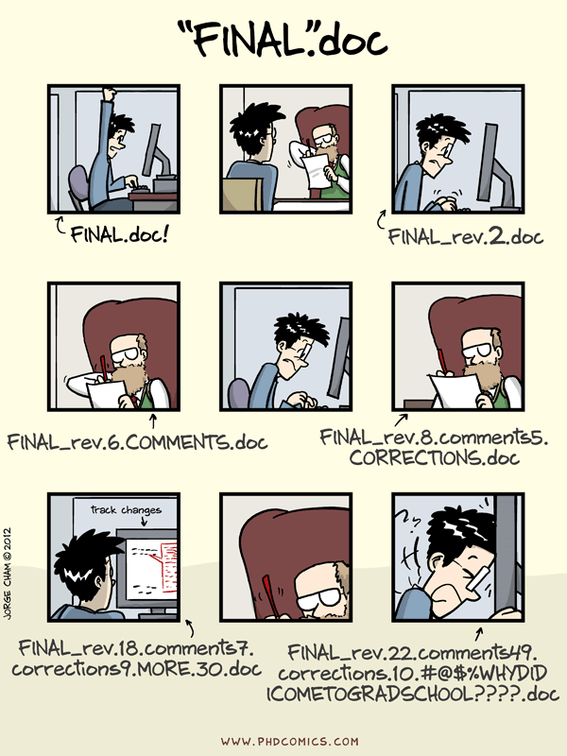

Slide 4
What is version control?
A version control system (VCS) is a program or set of programs that tracks changes to a collection of files.
One goal of a VCS is to easily recall earlier versions of individual files or of the entire project.
Another goal is to allow several team members to work on a project, even on the same files, at the same time without affecting each other's work.

Slide 5
Why version control?
Scenario : Multiple students are doing a project together
Question: Why not Google drive & One drive ????
Source code management Vs. File storage management

Slide 6
Types of version control
Local Version Control Systems
Centralized Version Control Systems
Distributed Version Control Systems

Slide 7
Local Version Control Systems
Many people’s version-control method of choice.
This approach is very common because it is so simple, but it is also incredibly error prone.
It is easy to forget which directory you’re in and accidentally write to the wrong file or copy over files you don’t mean to.

Slide 8
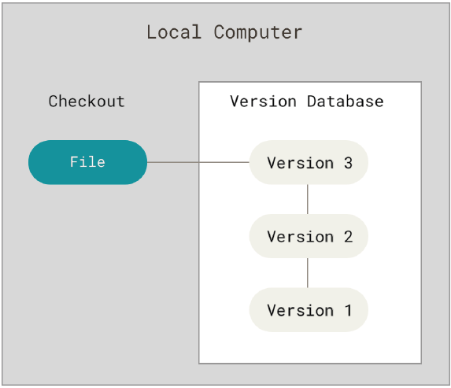
Local Version Control Systems

Slide 9
Centralized Version Control Systems
These systems have a single server that contains all the versioned files, and a number of clients that check out files from that central place.
Everyone knows to a certain degree what everyone else on the project is doing.

Slide 10
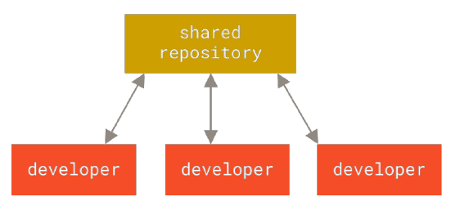
Centralized Version Control Systems

Slide 11
Distributed Version Control Systems
Clients don’t just check out the latest snapshot of the files; rather, they fully mirror the repository, including its full history.
If any server dies, and these systems were collaborating via that server, any of the client repositories can be copied back up to the server to restore it.
Every clone is really a full backup of all the data.

Slide 12
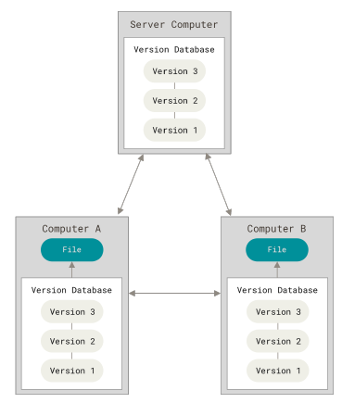
Distributed Version Control Systems

Slide 13
Why use Git?

Slide 14
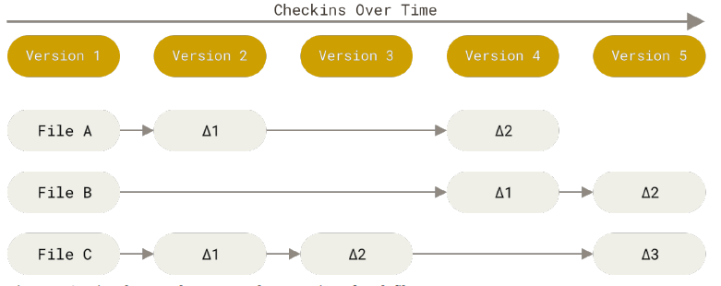
Snapshots, Not Differences
Most other systems store information as a list of file-based changes.
Other systems think of the information they store as a set of files and the changes made to each file over time

Slide 15
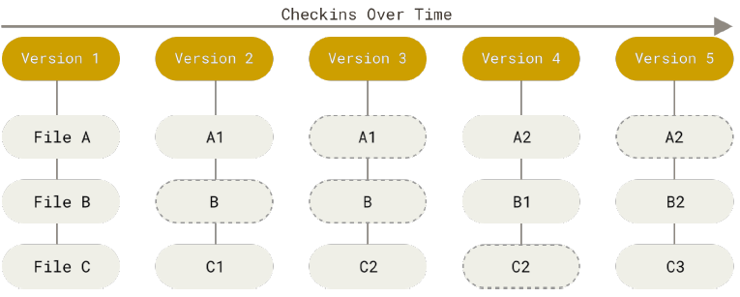
Snapshots, Not Differences
With Git, every time you commit, or save the state of your project, Git basically takes a picture of what all your files look like at that moment and stores a reference to that snapshot.
To be efficient, if files have not changed, Git doesn’t store the file again, just a link to the previous identical file it has already stored.

Slide 16
Nearly Every Operation Is Local
Most operations in Git need only local files and resources to operate — generally no information is needed from another computer on your network
Because you have the entire history of the project right there on your local disk, most operations seem almost instantaneous.
For example, to browse the history of the project, Git doesn’t need to go out to the server to get the history and display it for you — it simply reads it directly from your local database.

Slide 17
Git Has Integrity
Everything in Git is checksummed before it is stored and is then referred to by that checksum.
This means that it is impossible to change the contents of any file or directory without Git knowing about it.
Git uses the checksum format of SHA-1 hash. This is a 40-character string composed of hexadecimal characters (0–9 and a–f) and calculated based on the contents of a file or directory structure in Git
Ex. 24b9da6552252987aa493b52f8696cd6d3b00373

Slide 18
Git Installation
Git runs on any OS
But we will use the windows version
https://git-scm.com/download/win

Slide 19
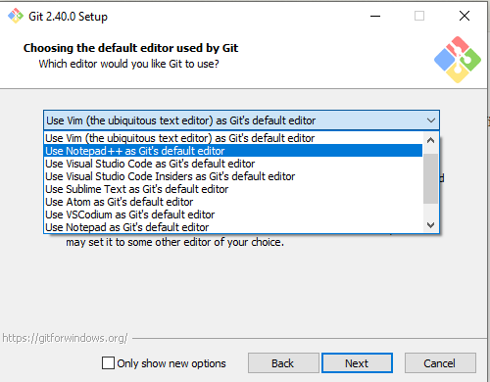
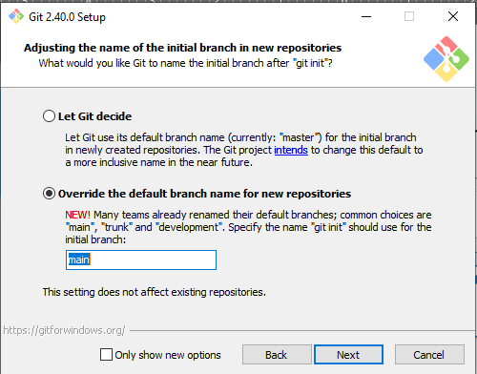
Remember these settings during installation

Slide 20
First-time Git Setup
Your Identity
The first thing you should do when you install Git is to set your user name and email address.
This is important because every Git commit uses this information, and it’s immutably baked into the commits you start creating.

Slide 21
First-time Git Setup
Your Identity
Type git config --global user.name <Name>
git config --global user.name “Juan Dela Cruz”
Type git config --global user.email <email>
git config --global user.email “youremail@test.com”

Slide 22
First-time Git Setup
Your Editor
Configure the default text editor that will be used when Git needs you to type in a message. If not configured, Git uses your system’s default editor.

Slide 23
First-time Git Setup
Your Editor
Type git config --global core.editor <name>
git config --global core.editor notepad
On a Windows system, if you want to use a different text editor, you must specify the full path to its executable file. This can be different depending on how your editor is packaged.
git config --global core.editor "'C:/Program Files/Notepad++/notepad++.exe‘ -multiInst -notabbar -nosession -noPlugin"

Slide 24
First-time Git Setup
Your default branch name
By default Git will create a branch called master when you create a new repository with git init. From Git version 2.28 onwards, you can set a different name for the initial branch.
‘Main’ is the standard usage of branch name.

Slide 25
First-time Git Setup
Your default branch name
git config --global init.defaultBranch main

Slide 26
First-time Git Setup
Check your settings
git config --list
Check settings including where Git is installed
git config -l --show-origin

Slide 27
Git Terminologies
Working tree: The set of nested directories and files that contain the project that's being worked on.
Repository (repo): The directory, located at the top level of a working tree, where Git keeps all the history and metadata for a project.
Hash: A number produced by a hash function that represents the contents of a file or another object as a fixed number of digits.

Slide 28
Git Terminologies
Object: A Git repo contains four types of objects, each uniquely identified by an SHA-1 hash. A blob object contains an ordinary file. A tree object represents a directory; it contains names, hashes, and permissions. A commit object represents a specific version of the working tree. A tag is a name attached to a commit.
Commit: When used as a verb, commit means to make a commit object. This action takes its name from commits to a database.
Branch: A branch is a named series of linked commits. The most recent commit on a branch is called the head. The default branch, which is created when you initialize a repository, is called main, often named master in Git. The head of the current branch is named HEAD.

Slide 29
Git Terminologies
Remote: A remote is a named reference to another Git repository. When you create a repo, Git creates a remote named origin that is the default remote for push and pull operations.
Commands, subcommands, and options: Git operations are performed by using commands like git push and git pull. git is the command, and push or pull is the subcommand.

Slide 30
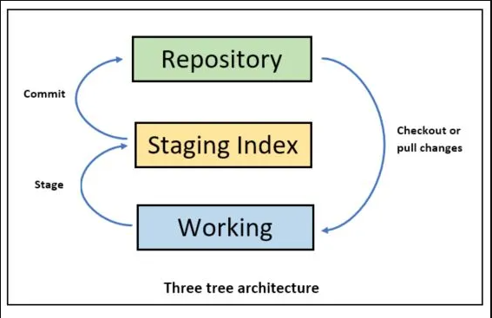
Git Architecture

Slide 31
Git Architecture
Repository
Commit
Staging
Checkout or Pull changes
Stage
Working
Three tree architecture

Slide 32
Git Demo

Slide 33
A simple Git workflow
Initialize a new project in a directory.
git init
Add a file to the directory
Add every change that has been made to the directory
git add <file>
Commit the change to the repository.
git commit -m “What you did”

Slide 34
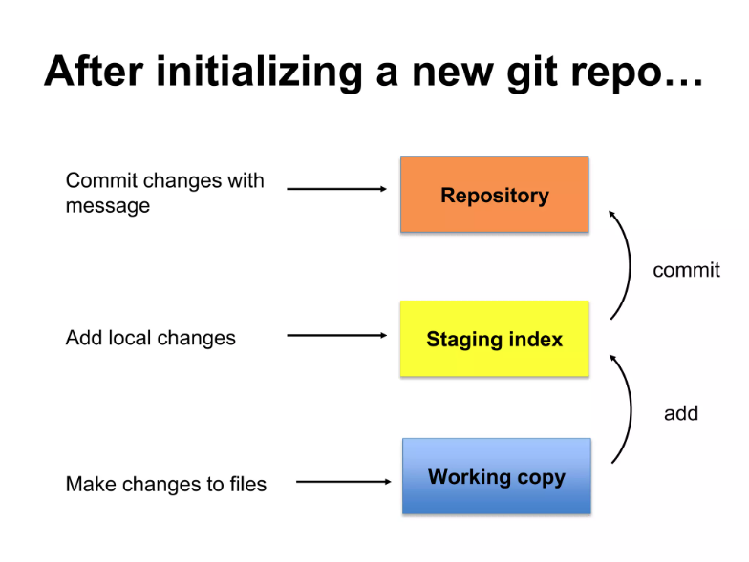

Slide 35
After initializing a new Git repo
Working Copy
Make changes to file
Add
Staging Index
Add local changes
Commit
Repository
Commit changes with
message

Slide 36
Commit Message
Tell what it does (Present tense)
Keep lines to <= 72 characters

Slide 37
Commit Message
Example 1:
Bad : “Fix spelling”
Good : “Fix the spacing of paragraph in the About page.”
Example 2:
Bad : “Fix syntax error”
Good : “Fix validation input in the login module.”

Slide 38
Look at the history of your code
Use git log to check all your commits
To minimize details, use git log --oneline
To limit the list of logs, use git log --oneline n<number> wherein number is the total logs to be displayed starting from HEAD.
You can also view the file history using checkout.
View the log commit
Copy a part of the hast of the log you want to checkout
Type git checkout <hash>

Slide 39
Git Checkout Demo

Slide 40
Ignoring Files
When sharing your code with others, there are often files or parts of your project, you do not want to share.
Examples:
Log files
Temporary files
Hidden files
Personal files
Sensitive data
Git can specify which files or parts of your project should be ignored by Git using a .gitignore file.
Git will not track files and folders specified in .gitignore. However, the .gitignore file itself IS tracked by Git.

Slide 41
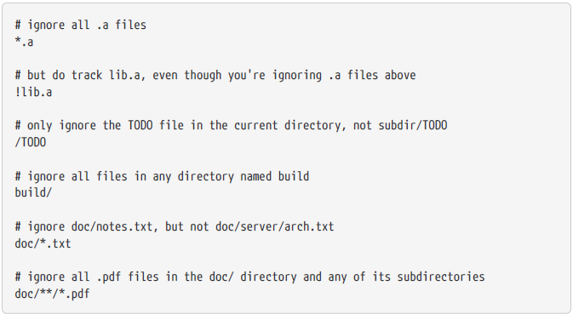
Ignoring Files

Slide 42
Ignoring Files

Slide 43
Git Ignore Demo

Slide 44
Git Branching
Branching means you diverge from the main line of development and continue to do work without messing with that main line.
Git branches are effectively a pointer to a snapshot of your changes. When you want to add a new feature or fix a bug—no matter how big or how small—you spawn a new branch to encapsulate your changes.

Slide 45
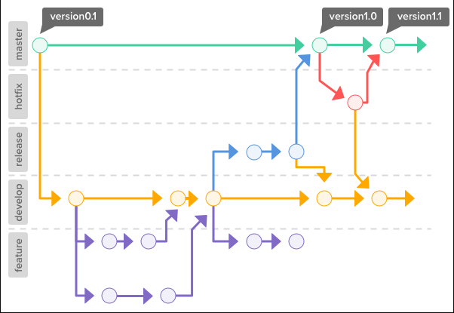
Git Branching

Slide 46
Merge a branch
Git's way of putting a forked history back together again.
The git merge command lets you take the independent lines of development created by git branch and integrate them into a single branch.

Slide 47
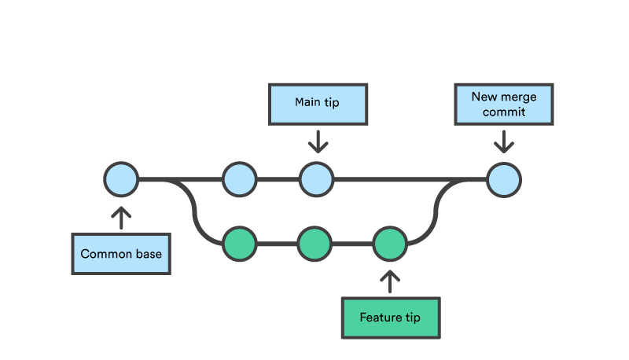
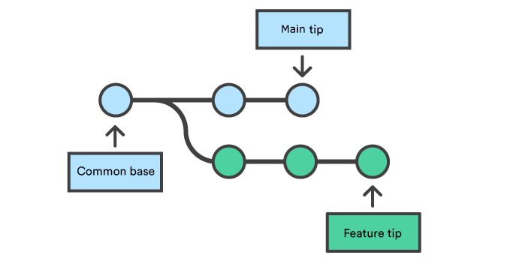
Merge a branch
How it works:

Slide 48
Basic Branching and Merging
Let’s go through a simple example of branching and merging with a workflow that you might use in the real world. You’ll follow these steps:
Do some work on a website.
Create a branch for a new user story you’re working on.
Do some work in that branch.

Slide 49
Basic Branching and Merging
At this stage, you’ll receive a call that another issue is critical and you need a hotfix. You’ll do the following:
Switch to your production branch.
Create a branch to add the hotfix.
After it’s tested, merge the hotfix branch, and push to production.
Switch back to your original user story and continue working.

Slide 50
Git Merge Demo

Slide 51
Fixing mistakes
Git lets you make changes fearlessly, because it always offers a way to get back to where you were. You can even change Git's commit history as long as you only change commits that haven't been shared.

Slide 52
Fixing mistakes
Scenario 1:
You updated a file to put additional information. Then you discovered that you made an error on your revision.
So you revised the file with correct entries. At this point, you could just commit the corrected file. But instead you prefer it in the same commit as the current.

Slide 53
Fixing mistakes
Solution 1:
git commit --amend --no-edit
The --no-edit option tells Git to make the change without changing the commit message. You can also use --amend to edit a commit message, to add files that were accidentally left out of the commit, or to remove files that were added by mistake.

Slide 54
Fixing mistakes
Scenario 2:
Imagine that you made a change to a source code file that broke the entire project, so you want to revert to the previous version of that file. Or perhaps you accidentally deleted a file altogether.
Git makes it easy to retrieve an earlier version, even if the current version no longer exists

Slide 55
Fixing mistakes
Solution 2:
If you've accidentally deleted a file, you can recover it by bringing the version from the index back into the working tree by using this command:
git checkout -- <file_name>
The -- in the argument list serves to separate the commit from the list of file paths. It's not strictly needed in this case, but if you had a branch named <file_name> (perhaps because that's the name of the file being worked on in that branch), -- would prevent Git from getting confused.
You can also check out a file from an earlier commit (typically, the head of another branch), but the default is to get the file from the index.

Slide 56
Fixing mistakes
Scenario 3:
You also can delete a file by using git rm. This command deletes the file on your disk, but it also has Git record the file deletion in the index.
If you ran this command:
git rm <file>
git checkout -- <file>
Git will return an error message
error: pathspec <file> did not match any file(s) known to git.

Slide 57
Fixing mistakes
Solution 3:
You could recover the file by using these commands:
git reset HEAD <file>
git checkout -- <file>
Here, git reset unstages the file deletion from Git. This command brings the file back to the index, but the file is still deleted on disk. You can then restore it to the disk from the index by using git checkout.

Slide 58
Git Recover Demo

Slide 59
Merge Conflicts
A merge conflict is an event that takes place when Git is unable to automatically resolve differences in code between two commits. Git can merge the changes automatically only if the commits are on different lines or branches.

Slide 60
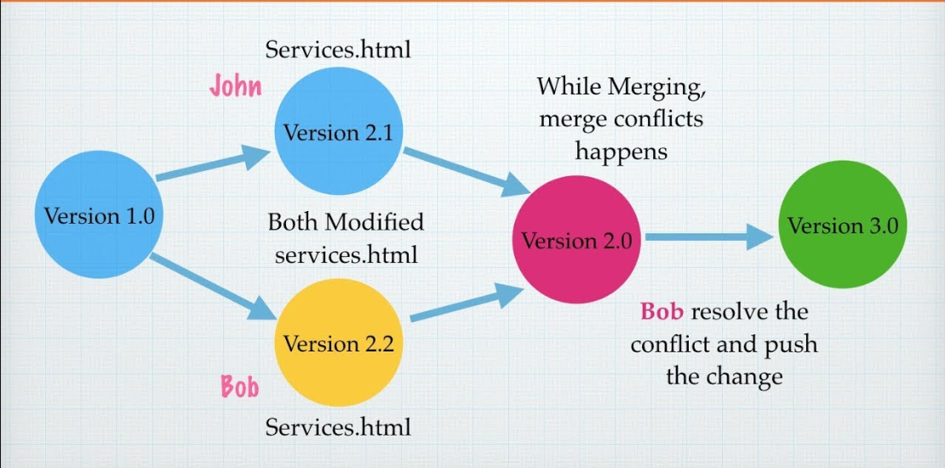
Merge Conflicts

Slide 61
Merge Conflicts
Types of Merge Conflicts
Starting the Merge Process - If there are changes in the working directory’s stage area for the current project, merging won’t start.
During the Merge Process - The failure during the merge process indicates that there is a conflict between the local branch and the branch being merged.

Slide 62
Merge Conflicts
How to Resolve Merge Conflicts
The easiest way to resolve a conflicted file is to open it and make any necessary changes
After editing the file, we can use the git add a command to stage the new merged content
The final step is to create a new commit with the help of the git commit command
Git will create a new merge commit to finalize the merge

Slide 63
Git Merge Conflict Demo

Slide 64
Git Workflows
Basic Workflow
Feature Branch Workflow
Git Flow

Slide 65

Git Workflows
Basic Workflow
There is one central repository. What this means is that each developer will clone the repo, work locally on the code, make a commit with various changes, and then finally put it in the central repository for other developers to take and put in their own individual work.
While the basic workflow is a fantastic method for creating and developing a simple website, it doesn’t do well with any complications. If two developers need to work on two separate functionalities inside one project, then the Basic workflow is no longer an ideal method for the team.

Slide 66
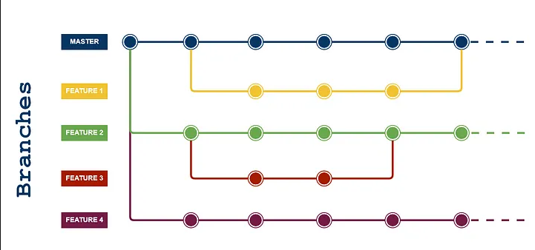
Git Workflows
Feature Branch Workflow
Assumes a central repository and master represents the official project history. Instead of committing directly on the master branch, developers can create a new branch every time they start work on a new feature.
Before a branch is merged to master, it needs to be verified and checked for errors. Junior developers can create a merge request and assign it to one of the senior developers. The Seniors in turn can review the code and leave any necessary comments. If everything seems satisfactory to move forward, the request is accepted and the branch is merged.

Slide 67
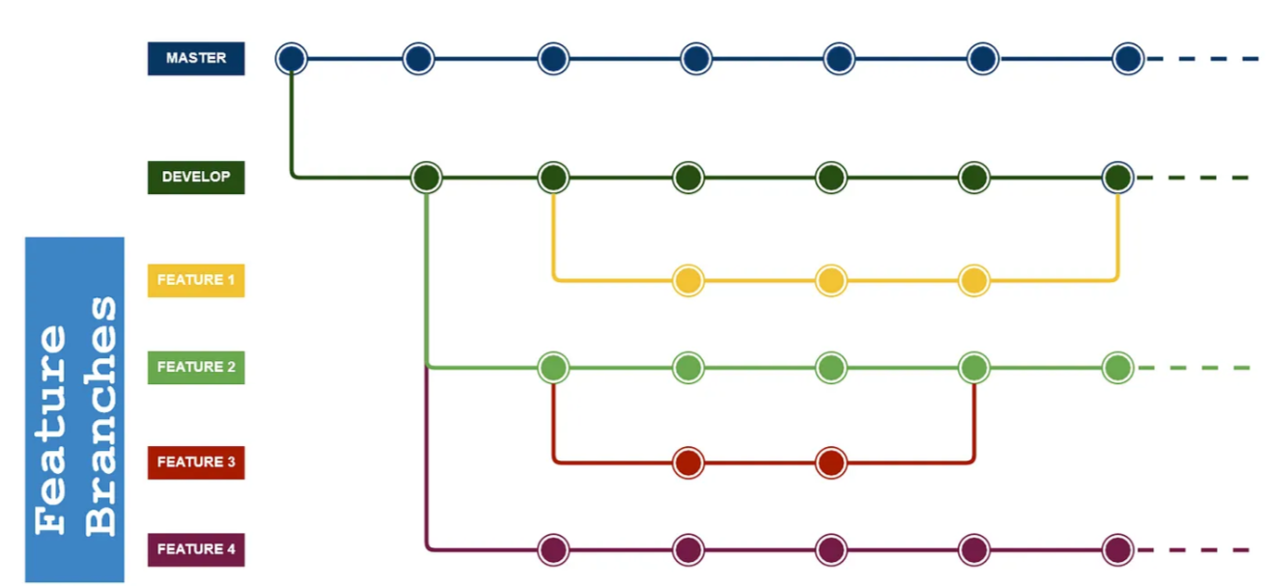
Git Workflows
Git Flow
The Git Flow is the most known workflow on this list. It is almost similar to the feature branch workflow.
But the difference is the developers are creating branches from the develop branch and it is a branch of master branch. Developers are not allowed to create branches directly from master branch. This flow eliminates buggy code from the master branch.

Slide 68
GitHub
GitHub is the single largest host for Git repositories, and is the central point of collaboration for millions of developers and projects
A large percentage of all Git repositories are hosted on GitHub, and many open-source projects use it for Git hosting, issue tracking, code review, and other things.

Slide 69
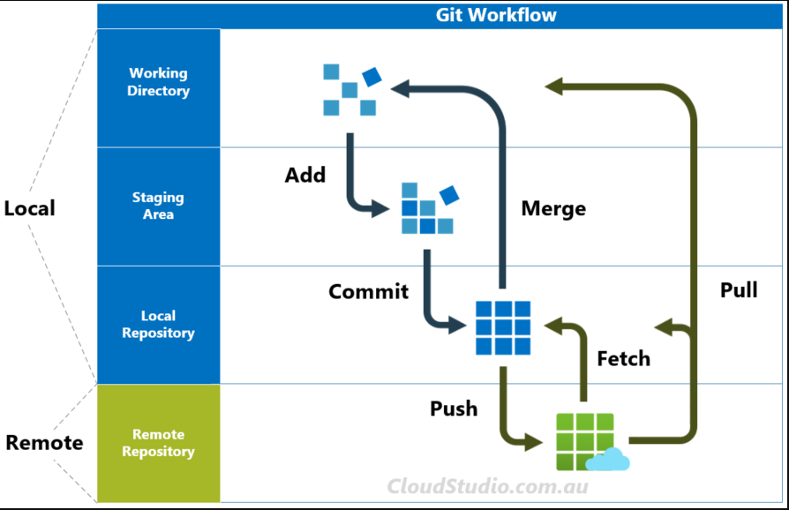
GitHub

